Slide 1
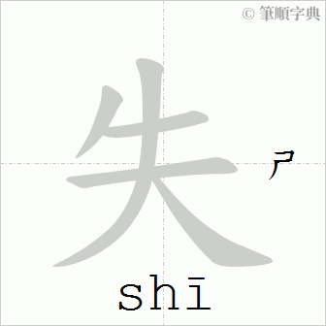
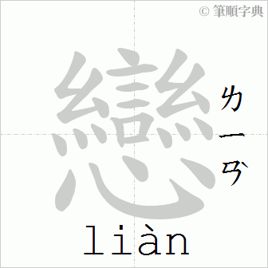

失戀
Be crossed in love

Slide 2
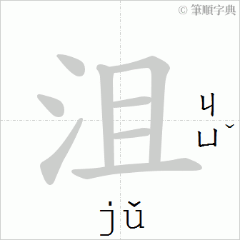
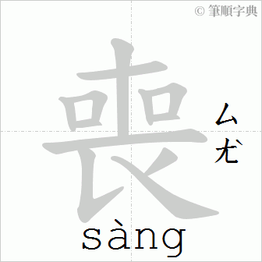
沮喪
Depressed

Slide 3

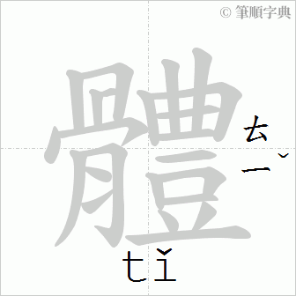
身體
Body；

Slide 4
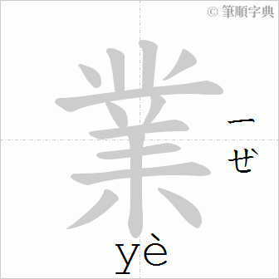
作業
Homework

Slide 5
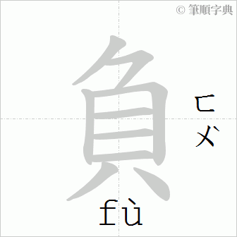
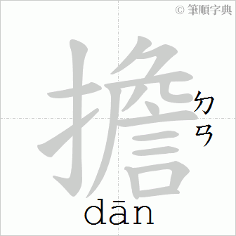
負擔
Burden

Slide 6

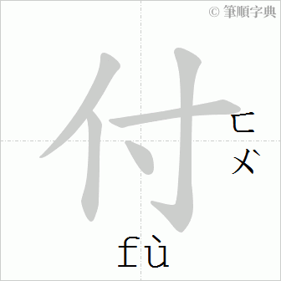
對付
To deal with

Slide 7

女朋友跟他吹了
His girlfriend broke up with him.

Slide 8

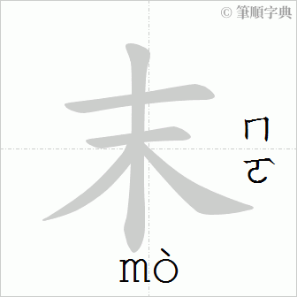
週末
Weekend

Slide 9
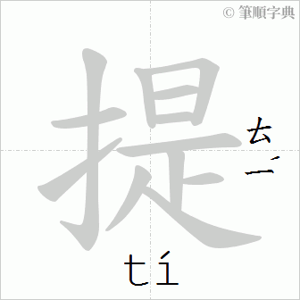
提出來
to bring up

Slide 10


帥
Handsome

Slide 11
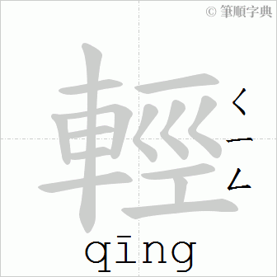
年輕
young

Slide 12
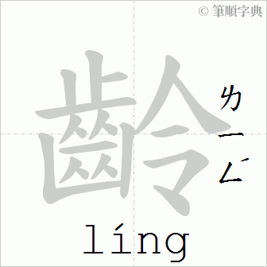
年齡
Age

Slide 13

尊重
Respect

Slide 14
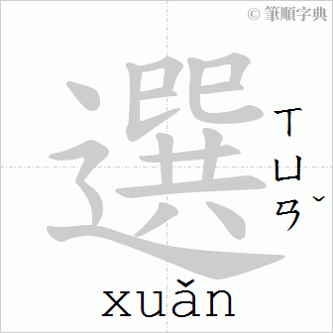
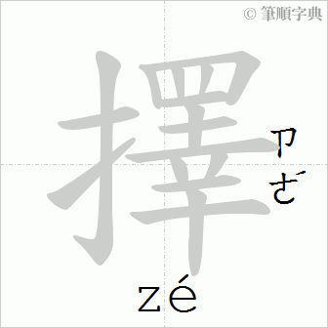
選擇
Choice；to choose

Slide 15

變了一個人
Be a different person

Slide 16

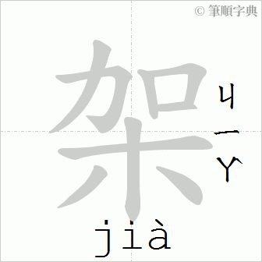
吵架
Quarrel

Slide 17
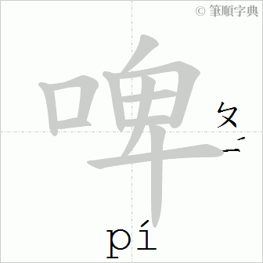
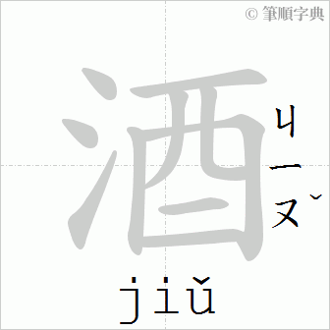
啤酒
Beer

Slide 18
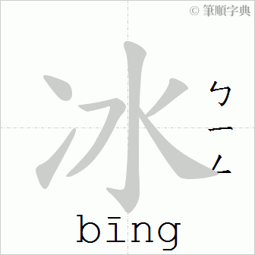

冰鎮
Iced

Slide 19
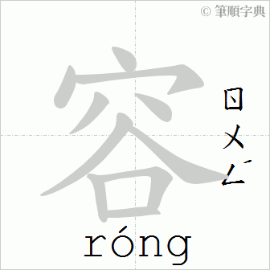
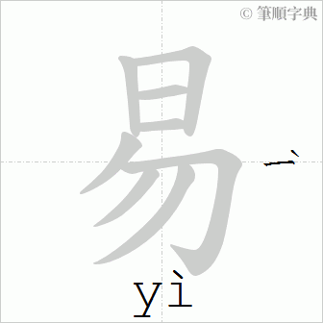
容易
Easy

Slide 20

喝醉了
Drunk

Slide 21
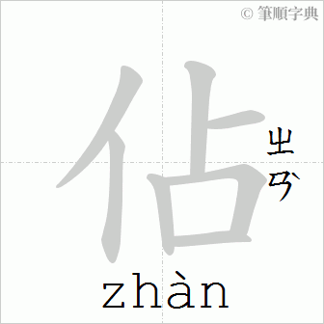
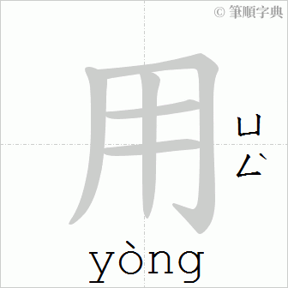
佔用
Take up

Slide 22

（Sb）被甩了
Be dumped

Slide 23
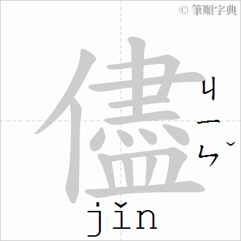

儘管找我
Just call me

Slide 24
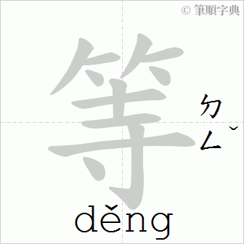
等你
To wait for you

