Slide 1
第八課
Lesson Eight

Slide 2
考試
To take an examination

Slide 3
起床
To get up

Slide 4
一天到晚
All day

Slide 5
復習功課
review

Slide 6
復習功課
Review the homework

Slide 7
累極了
exhausted

Slide 8
飯不香
Food is tasteless.

Slide 9
飯不香
Poor appetite

Slide 10
不夠
Not enough

Slide 11
沒精打采的
be listless

Slide 12
現在
now

Slide 13
…（的）時候
When…

Slide 14
寫
To write

Slide 15
以爲
To think

Slide 16
喝
To drink coffee

Slide 17
會好的
will get better

Slide 18
沒有用
useless

Slide 19
家裡（人）
family

Slide 20
打了個電話
Made a phone call

Slide 21
應該
should

Slide 22
睡一覺
Have a sleep

Slide 23
很精神
To be very energetic

Slide 24
好像…（似的）
It seems that …

Slide 25
勁兒
strength，energy

Slide 26
向來
all along，always

Slide 27
早睡早起
To keep early hours

Slide 28
跑步
To run

Slide 29
鍛煉
To exercise

Slide 30
這天晚上
This evening

Slide 31
做了一個好夢
Had a good dream

Slide 32
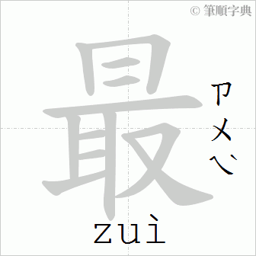
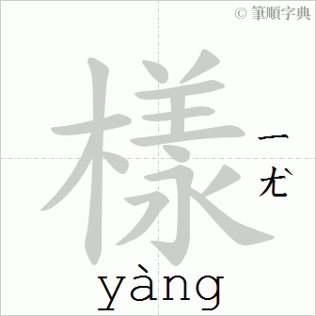
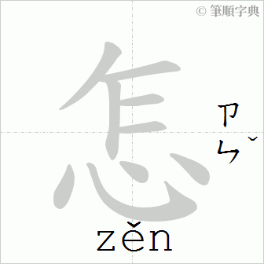
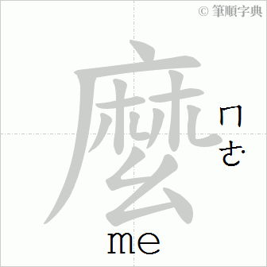
最近怎麽樣？
How have you been lately？

Slide 33
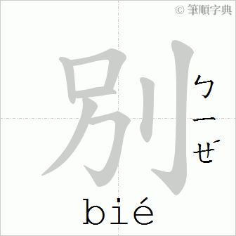
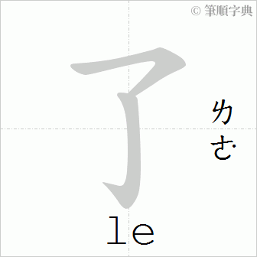
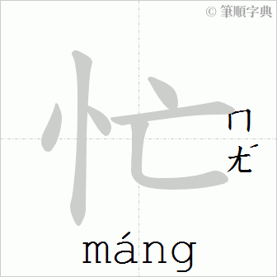
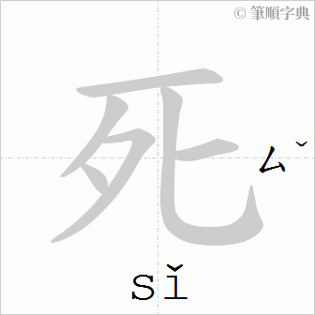
別提了，忙死了。
Don‘t mention it. I
am crazily busy.

Slide 34
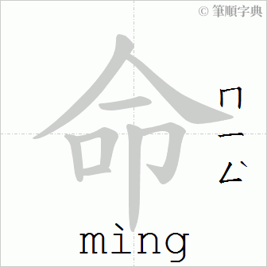
真要命！
It‘s killing me！

Slide 35
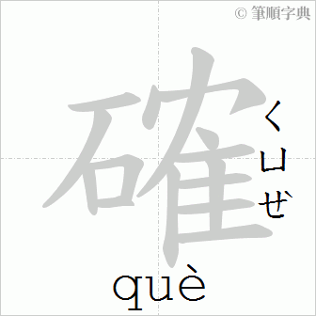
的確
díquè
indeed

Slide 36
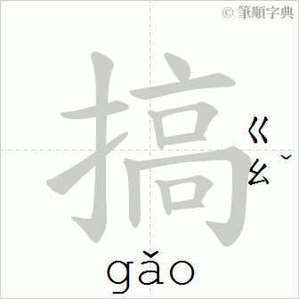
不知道怎麼搞的
I don’t know what ‘s going on.

Slide 37
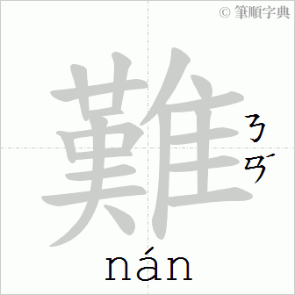
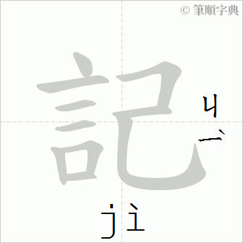
難記
Difficult to remember.

Slide 38
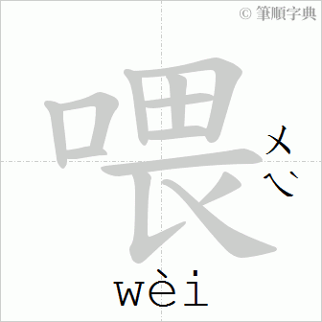
喂？喂！
Hello？Hello！

Slide 39
總是
always

Slide 40
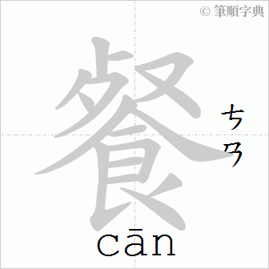
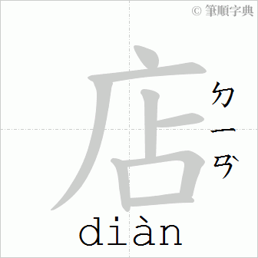
快餐店
Fast-food restaurant

Slide 41
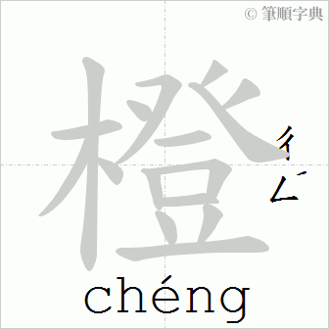
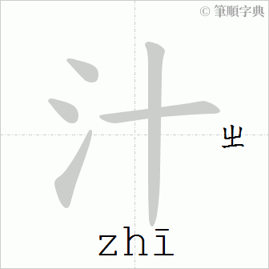
橙汁
Orange juice

Slide 42
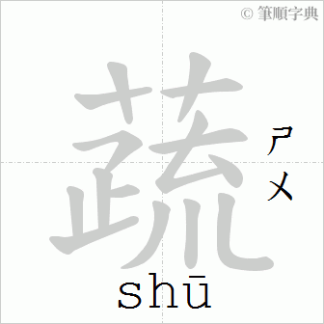
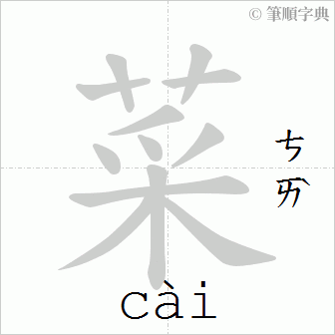
蔬菜
vegetable

Slide 43
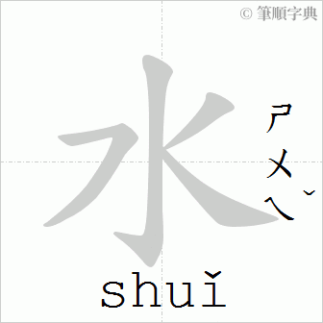
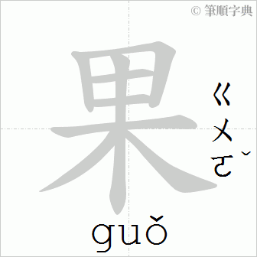
水果
Fruit（s）

Slide 44
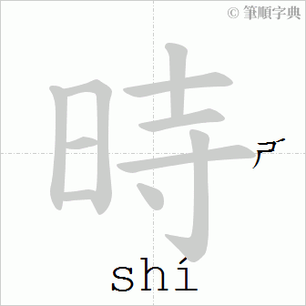
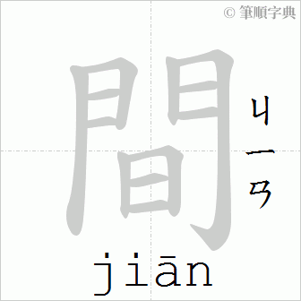
時間
Time for specific event

Slide 45
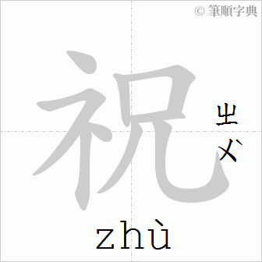
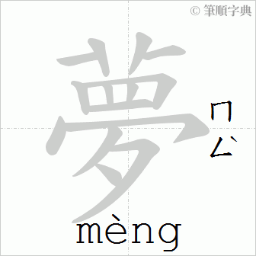
祝你做個好夢！
Sweet dreams！

