Slide 1
愛好（hào ）
hobby

Slide 2
各有所愛
Each has their own
Hobby.

Slide 3
志趣
interests

Slide 4
相投
congenial

Slide 5
氣氛
atmosphere

Slide 6
十分活躍
Very lively

Slide 7
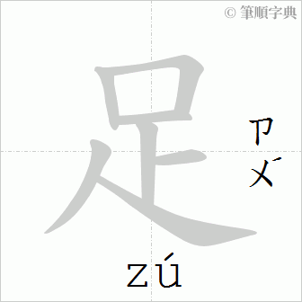
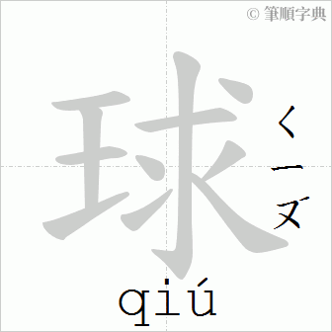
踢足球
To play football

Slide 8
騎自行車
to ride a bike

Slide 9
打棒球
To play baseball

Slide 10
打籃球
To play basketball

Slide 11
打網球
To play tennis

Slide 12
游泳
to swim

Slide 13
畫畫
to draw

Slide 14
下棋
to play chess

Slide 15
彈吉他
to play the guitar

Slide 16
書法
Calligraphy

Slide 17
逗你玩兒
Just teasing you.

Slide 18
接著Verb
Continue doing

Slide 19
專 業
major

Slide 20
主 修
to specialize

Slide 21
彈鋼琴
piano

Slide 22
對牛彈琴
to play the lute to a cow
address the wrong audience

Slide 23
下圍棋
go

