Slide 1
第三課
Lesson Three

Slide 2
李家奇家
Li Jiaqi‘s family

Slide 3
有六口人
Has six +MW+people

Slide 4
爸爸、媽媽
Dad，mom

Slide 5
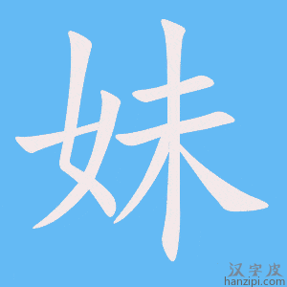
兩個妹妹
two +Measure Word younger sisters

Slide 6
一個弟弟
one +Measure Word younger brother

Slide 7
還有他
Also he/him

Slide 8
家奇是
Jiaqi is

Slide 9
老大
The eldest child

Slide 10
他爸爸
His dad

Slide 11
是做生意的
does business

Slide 12
也很忙
also very busy

Slide 13
很辛苦
very laborious

Slide 14
家裡人
People in his family

Slide 15
都
都 all

Slide 16
叫他大忙人
Call him Mr Busy

Slide 17
因爲
because

Slide 18
弟弟妹妹
Younger brother ord younger sister

Slide 19
很小
very little/young

Slide 20
所以
therefore

Slide 21
他媽媽
His mom

Slide 22
不工作
not Work

Slide 23
在家照顧
At home take care

Slide 24
弟弟妹妹
Younger brother ord younger sister

Slide 25
同學說
Classmates said

Slide 26
因爲
because

Slide 27
他爸爸
His dad

Slide 28
很有錢
Has lots of money/very rich

Slide 29
所以
therefore

Slide 30
他媽媽
His mom

Slide 31
不工作
not Work

Slide 32
家奇說
Jiaqi said

Slide 33
不對
Not correct

Slide 34
因爲
It is because

Slide 35
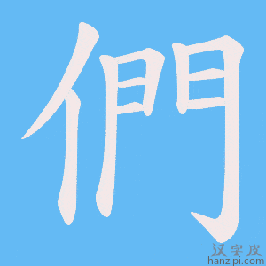
他們家
Their family

Slide 36
錢不夠/够
Money not enough

Slide 37
所以
therefore

Slide 38
不能
Not able/can’t

Slide 39
請人
Hire people

Slide 40
照顧
take care

Slide 41
他的
His

Slide 42
弟弟妹妹
Younger brother ord younger sister

Slide 43
要介紹一下
Will introduce a little bit

Slide 44
自己的
Oneself‘s

Slide 45
家庭
family （formal expression）

Slide 46
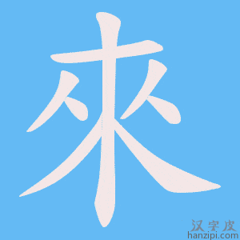
誰先來？
Who will go/speak first？

Slide 47
問問題
Ask questions

Slide 48
一共
In total

Slide 49
一定
definitely

Slide 50
在一起
To be together

Slide 51
親人
Family member

Slide 52
教音樂
Teach music

Slide 53
可愛
Cute，adorable

Slide 54
幾口人
How many（less than 10） people （in a family）？

Slide 55
七口人
Seven people （in a family）

Slide 56
爺爺奶奶
Grandapa grandma

Slide 57
兒子女兒
son, daughter

Slide 58
孫子孫女
Grandson granddaughter

Slide 59
幸福
Happy （inside），content

Slide 60
一樣
The same 的+（Noun）

Slide 61
這樣的+N
This kind of + Noun

Slide 62
那個
That +Measure Word

Slide 63
小寶寶
Little baby

Slide 64
寶貝
baby/treasure

Slide 65
事情
Things （to do）

Slide 66
明白了
Got it now.

Slide 67
呵呵
Hehe😄

