Slide 1
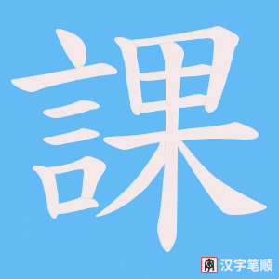
第三課
Lesson Three

Slide 2
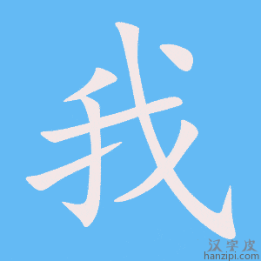
我的家
My Family

Slide 3
李家興家
Li Jiaxing‘s family

Slide 4
Robert叫李家興
…is named Li Jiaxing…

Slide 5
有
to have

Slide 6
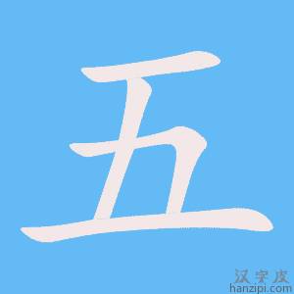
五口人
Five +MW+people

Slide 7
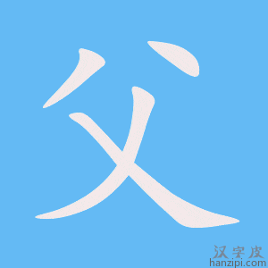
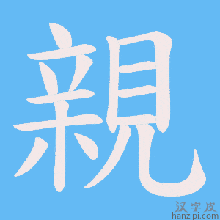
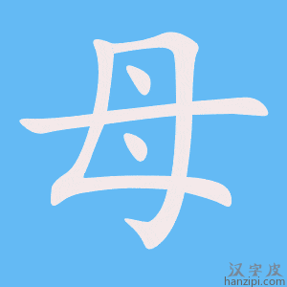
父親、母親
Father ，mother

Slide 8
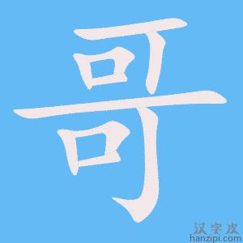
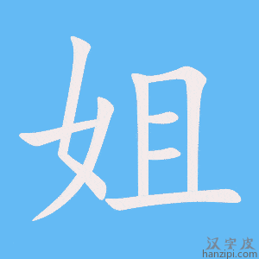
哥哥，姐姐
Elder brother +elder sister

Slide 9
和他
And he/him

Slide 10
他父親
His father

Slide 11
是
IS

Slide 12
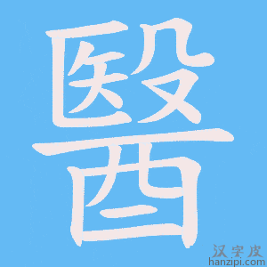
醫生
doctor

Slide 13
母親
mother

Slide 14
是
IS

Slide 15
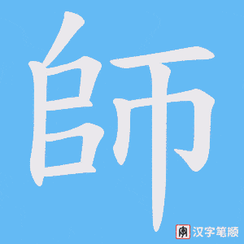
老師
teacher

Slide 16
哥哥
Elder brother

Slide 17
是
IS

Slide 18
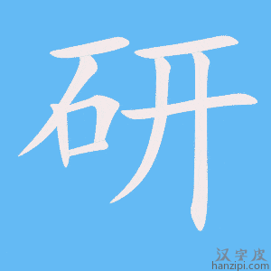
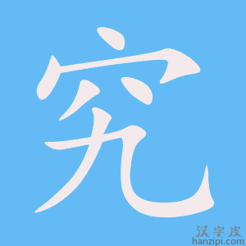
研究生
Graduate student

Slide 19
姐姐
elder sister

Slide 20
是
IS

Slide 21
大學生
College student

Slide 22
他父親
His father

Slide 23
因爲
because

Slide 24
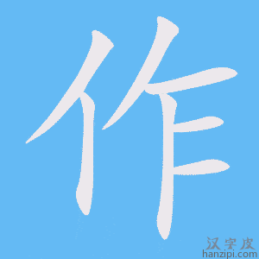
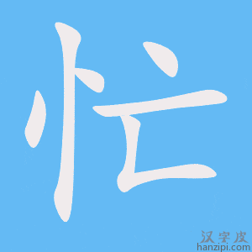
工作忙
Work is busy

Slide 25
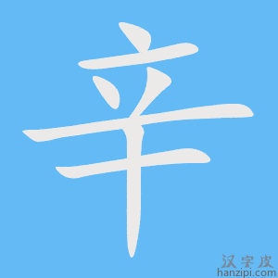
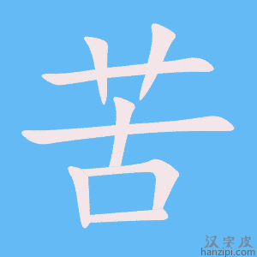
很辛苦
very laborious

Slide 26
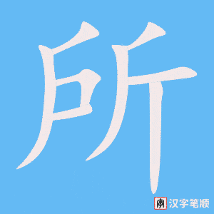
所以
therefore

Slide 27
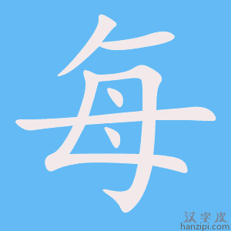
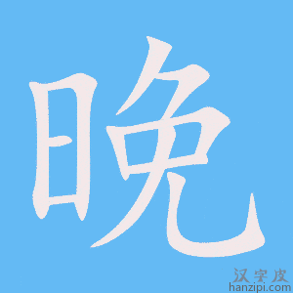
每天晚上都
every evening all

Slide 28
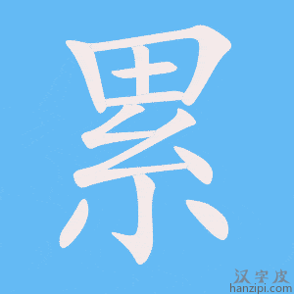
覺得很累
Feels very tired

Slide 29
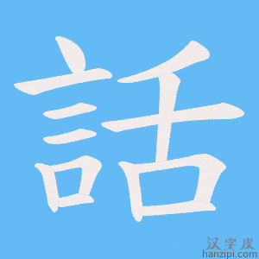
不想說話
Don’t want to talk

Slide 30
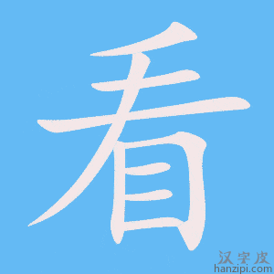
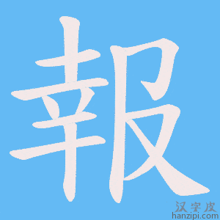
不想看報
Don’t want to read newspaper

Slide 31
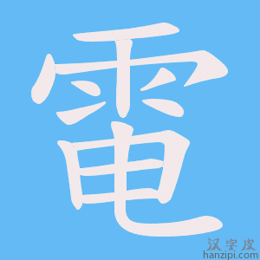
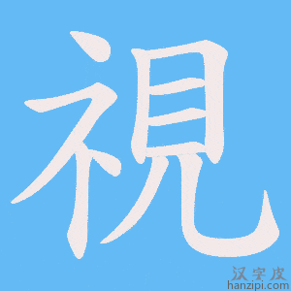
也不想看電視
Also don’t want to watch TV

Slide 32
他母親
His mother

Slide 33
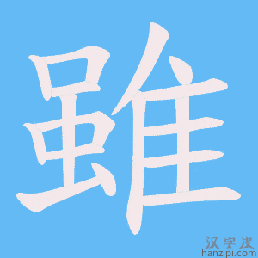
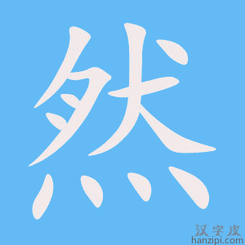
雖然
although

Slide 34
也很忙
also very busy

Slide 35
很辛苦
very laborious

Slide 36
可是
but

Slide 37
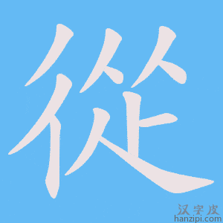
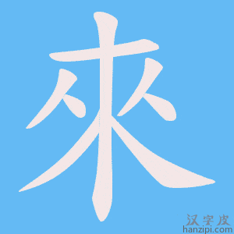
從來
never

Slide 38
覺得累
Feels tired

Slide 39
每天+（都）
Everyday +（都）

Slide 40
他母親
His mother

Slide 41
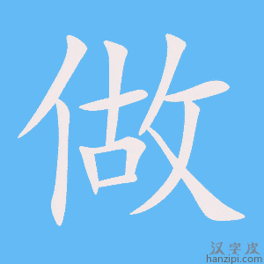
都
（每天）都 cook

Slide 42
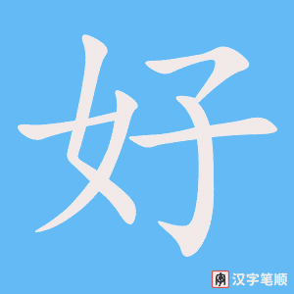
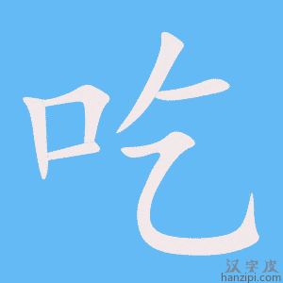
好吃的
Yummy/delicious

Slide 43
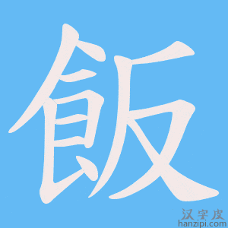
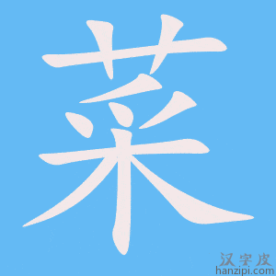
飯菜
Meal （dishes）

Slide 44
中國菜
Chinese dish/food

Slide 45
法國菜
French dish/food

Slide 46
意大利菜
Italian food

Slide 47
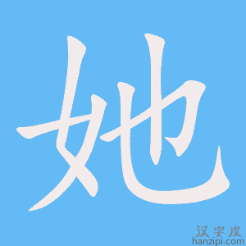
她都會做
she all can cook/She knows how to cook them all.

Slide 48
因爲
because

Slide 49
家興
Jiaxing

Slide 50
是
to be

Slide 51
老小
Youngest （among the siblings）

Slide 52
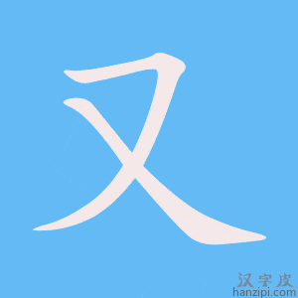
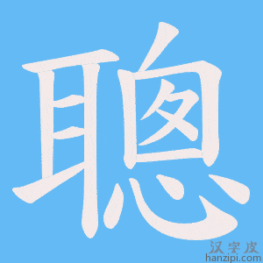
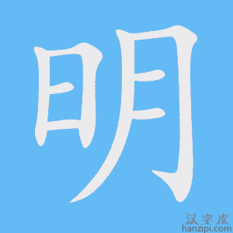
人又聰明
Person（jiaxing）whatsmore smart

Slide 53
所以
therefore

Slide 54
他的母親
His mother

Slide 55
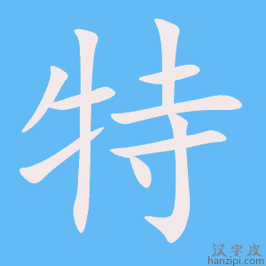
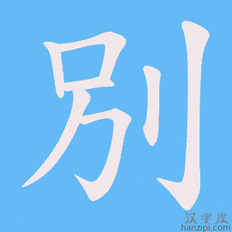
特別
especially

Slide 56
喜歡他
Likes him

